Slide 1

HR ANALYTICS DASHBOARD USING POWER BI
Presented By :
Swetha M

Slide 2


Introduction
The HR Analytics Dashboard is a Power BI-based project that provides insightful visualizations and analysis of human resources data.
It offers HR professionals a comprehensive overview of key metrics and trends, enabling data-driven decision-making to optimize HR processes and improve employee engagement.
With this dashboard, HR professionals gain crucial insights into key areas such as Employee Count, Attrition Trends, Demographics, Job satisfaction levels, and more.
HR teams can use its capabilities to make smart decisions and effectively manage workforce.

Slide 3


Technologies Used
Power BI
→ Power BI is a business analytics service by Microsoft that provides interactive visualizations and business intelligence capabilities.
→ It enables users to create reports and dashboards from various data sources, offering deep insights and data-driven decision-making.
Microsoft EXCEL
→ Excel integrates with Power BI to import data,enabling dynamic visualizations and real - time analysis.
→ It also allows publishing reports to Power BI for easy sharing and access.

Slide 4

Dataset
The dataset contains 41 columns covering demographic, financial, and performance metrics.
Contains both categorical and numerical data.
Useful for HR analytics, particularly for understanding attrition patterns, employee satisfaction, and performance.
Attrition: Shows if the employee left the company (Yes or No).
Business Travel: Frequency of work-related travel (Rarely, Frequently).
Age Group: Categorizes employees by age ranges (e.g., 25-34, 35-44).
Employee Status: Classifies employees as Current or Former.
Department: Specifies the division, such as Sales or R&D.
Education Field: Employee's field of study (e.g., Medical, Life Sciences).
Demographics: Includes gender, marital status, and job title.
Financial Data: Covers daily rate, monthly income, and commute distance.
Performance Metrics: Includes job satisfaction, work-life balance, and ratings.
Tenure Data: Tracks years at the company, in the role, and with the manager.

Slide 5

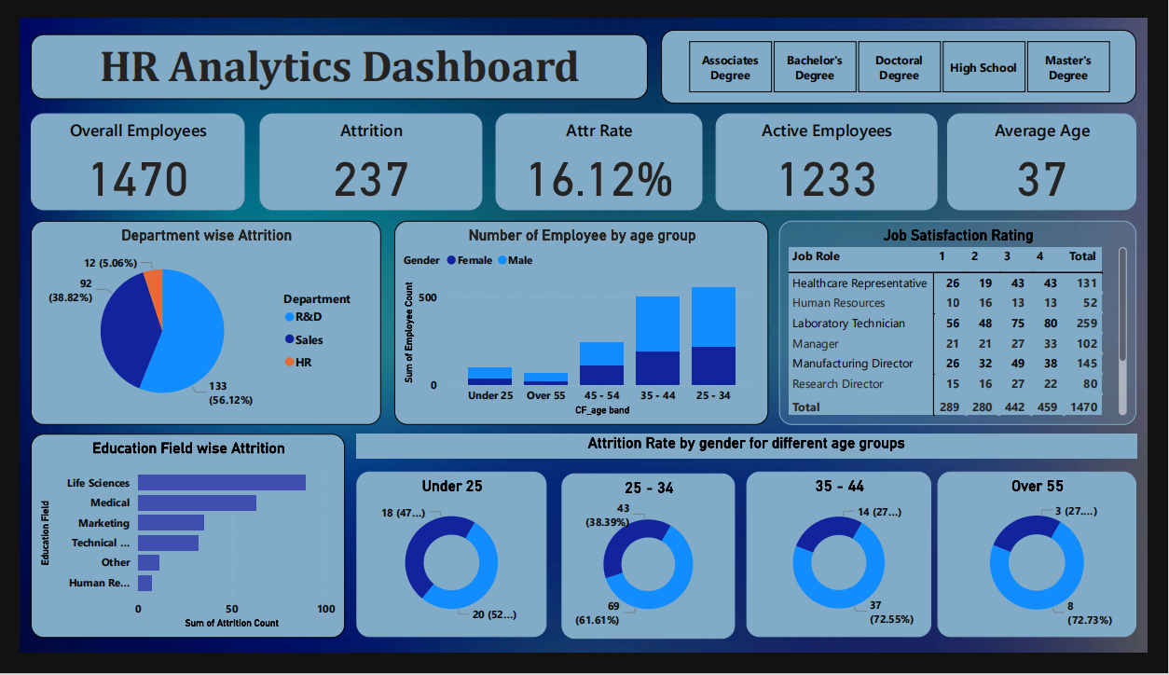
Dashboard
.

Slide 6
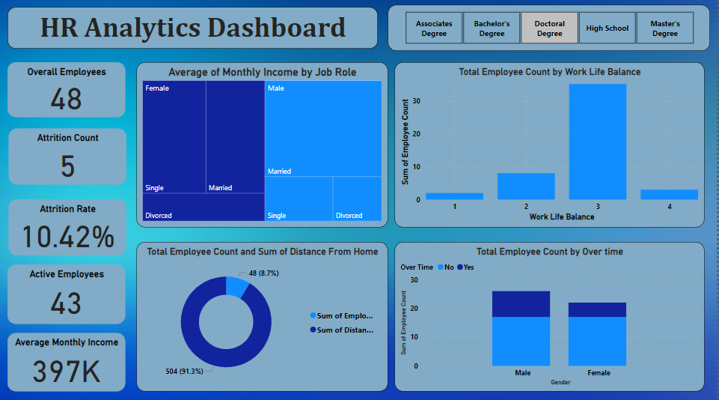
Sheet 2

Slide 7


Steps Overview
Data subset collected from online.
Understanding the Data.
Data Cleaning & Finding Missing values.
Data Visualization.

Slide 8

Dashboard Content
KPI
Employee Count : This provides a snapshot of the total number of employees in organization.
Attrition Count : This indicates the number of employees who have left the company.
Attrition Rate : This calculates the percentage of employees who have left, relative to the total employees count.
Active Employees : This represents the number of employees who are currently employed in organization.
Average Age : This shows the average Age of the Employees.
Department Wise Attrition
This pie chart represents the distribution of attrition across different departments in organization. It allows us to compare attrition rates between departments visually.

Slide 9

Number of Employees By Age Group
By creating age groups using clustered column chart, this bar graph illustrates the distribution of employees across different age ranges. It helps identify age-related trends in workforce.
Job Satisfaction Rate
The matrix chart showcases job satisfaction ratings for different job roles or positions. It enables us to identify areas of high or low job satisfaction within organization.
Education Field Wise Attrition
This bar graph presents the attrition rates categorized by education fields. It helps determine if there are any specific education fields with higher attrition rates.
Attrition Rate By Gender For Different Age Group
The donut chart show the attrition rates segmented by gender within different age groups.
It provides a visual breakdown of attrition patterns based on age and gender.

Slide 10

Conclusion
The HR Analytics Dashboard is a Power BI tool that offers real-time insights into key HR metrics.
It features interactive visualizations, including a Department-wise Attrition Pie Chart, Age Group Column Chart, Job Satisfaction Heat Map, Education Field-wise Attrition Bar Graph, and Gender-Age Attrition Donut Chart.
Designed for data-driven decision-making, it helps HR professionals track trends, optimize processes, and enhance employee engagement, fostering a positive work environment through a user-friendly interface.

Slide 11


